Slide 1
INSTRUCTOR INFORMATION – DO NOT PRESENT
Lab Setup / Notes
Instructor creates On-Demand Lab (ODL) in Spektra Portal Manager: https://experience-azure-mgmt.azurewebsites.net/#/main
Hot instances should be set to DISABLED when ODL is created
At least 1 hour before event starts, hot instances should be ENABLED and set to one (1). Return back to the on-demand lab page and for your lab, under the ACTIONS column, set “Check Hot Instances”. Click the “Add hot instances” link and set the number of hot instances to accommodate the number of registrants. Current provision time (11/29/17) is approximately 35 minutes per instance; Instances should provision concurrently. Recommending starting this at least 75-90 minutes prior to start.
The background of the main title slide should be changed to reflect the city you are presenting in (optional)
Change the City / State / Date of the presentation on the main title slide
Insert SI partner logo on main title slide in upper right corner
On the whiteboard, instructors should write the registration URL for CloudEndure challenge 3. Do not distribute: https://azure-register.cloudendure.com/
There is a nodeJS / mongodb application running on the migrate-host virtual machine; For the initial delivery of this lab, it will not be utilized. You may reference it and demonstrate before/after accessibility however hands-on instruction for this will be included at a later date as part of Challenge 3
To prepare for challenge 4, attendees will need to fill out the e-mail form at https://aka.ms/challenge4 -- the output of this file is located at https://wolverine.itscloudy.af/liftshift/private/registrants.html Login as “lsadmin” The password is: LiftShift123! This registrants.html file will be reset (blanked) every morning at 3am so it should be empty for you prior to starting
Find out location of restrooms to inform attendees at start of session
Repairing VNC black-screen
Occasionally when users authenticate to the noVNC interface they will get a black screen instead of the Linux desktop. This is a known issue and will be addressed at a later date. For now, rebooting the host seems to clear the issue and allow the user to connect
Determine the name of the resource group the affected user has been assigned, for example “ODL-LIFTSHIFT-4905”
Have the Microsoft FTE log into https://portal.azure.com with the GBB admin subscription credentials; The credentials are confidential and cannot be shared.
Request a cloud shell
Enter the following command: az vm list -d -o table | grep #### (where #### is the numeric resource group instance, for example “4905”)
The IP address of the host VM should be displayed
SSH to the affected host on port 2112 as the user “lsadmin”: ssh lsadmin@IPADDRESS -p 2112 The password is: LiftShift123!
Switch to the root user: su - root The password is: Microsoft
Type “reboot” and press enter – the host should now reboot; When the host returns the black screen should hopefully yield to the Linux desktop
*CONFIDENTIAL*

Slide 2
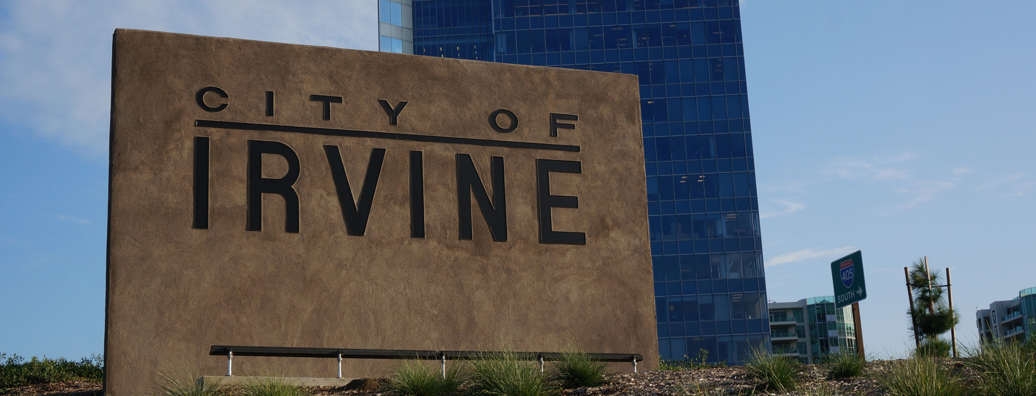

Azure Linux Migration Workshop
Analyzing, Migrating, Deploying & Modernizing Linux workloads in Microsoft Azure
Irvine, CA – December 4 / 2017
Program Leads:
Stuart Kirk & Sean Mikha
Notes:
(Introductions and set expectations that this presentation is designed to discuss the role of Azure as the cloud computing platform for a business’s digital transformation.)

Slide 3


Azure Linux Migration Workshop
Analyzing, Migrating, Deploying & Modernizing Linux workloads in Microsoft Azure
New York, NY– December 5 / 2017
Program Leads:
Stuart Kirk & Sean Mikha
Notes:
(Introductions and set expectations that this presentation is designed to discuss the role of Azure as the cloud computing platform for a business’s digital transformation.)

Slide 4

Azure Linux Migration Workshop
Analyzing, Migrating, Deploying & Modernizing Linux workloads in Microsoft Azure
Reston, VA – December 13 / 2017
Program Leads:
Stuart Kirk & Sean Mikha
Notes:
(Introductions and set expectations that this presentation is designed to discuss the role of Azure as the cloud computing platform for a business’s digital transformation.)

Slide 5

Azure Linux Migration Workshop
Analyzing, Migrating, Deploying & Modernizing Linux workloads in Microsoft Azure
Dallas, TX – December 18 / 2017
Program Leads:
Stuart Kirk & Sean Mikha
Notes:
(Introductions and set expectations that this presentation is designed to discuss the role of Azure as the cloud computing platform for a business’s digital transformation.)

Slide 6

Azure Linux Migration Workshop
Analyzing, Migrating, Deploying & Modernizing Linux workloads in Microsoft Azure
Boston, MA – December 19 / 2017
Program Leads:
Stuart Kirk & Sean Mikha
Notes:
(Introductions and set expectations that this presentation is designed to discuss the role of Azure as the cloud computing platform for a business’s digital transformation.)

Slide 7


Azure Linux Migration Workshop
Analyzing, Migrating, Deploying & Modernizing Linux workloads in Microsoft Azure
Toronto, ON – January 16 / 2018
Program Leads:
Stuart Kirk & Sean Mikha
Notes:
(Introductions and set expectations that this presentation is designed to discuss the role of Azure as the cloud computing platform for a business’s digital transformation.)

Slide 8
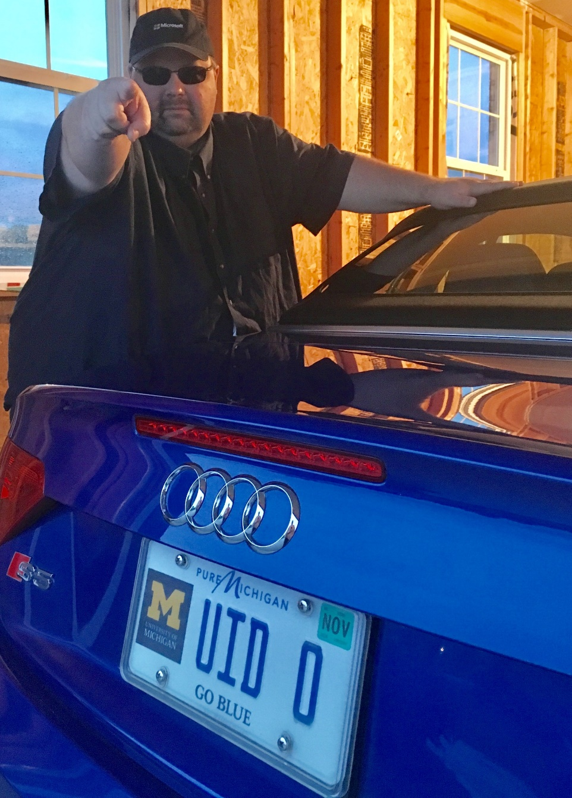
STUART KIRK
Microsoft Global Black Belt – Open Source Linux Infrastructure
Home: Ann Arbor, Michigan, originally from Canada
Engaging with Microsoft clients in North America to architect and migrate open source workloads hosted on Microsoft Azure.
Entirety of career in Open Source: Dell, Cisco, Red Hat
Joined Microsoft in June 2016
MCSA: Linux on Azure, MCSD: Azure Solutions Architect
RHCA, RHCE, RHCSA, RHCDS, RHCVA
Twitter: @StuartAtMSFT
LinkedIn: https://www.linkedin.com/in/stuartkirk

Slide 9

SEAN MIKHA
Open Source Technology Solutions Professional – Data Platform
Home: San Diego, California
Specialize in Data Warehouse, Big Data, NoSQL, and Advanced Analytics workloads
5+ year history with Microsoft
10+ years experience with Hadoop & Big Data Projects
MCSA: Cloud Platform, MS Data Science Professional Degree
Avid fan of blockchain and crypto-currency technologies
Twitter: @SeanMikha
LinkedIn: https://www.linkedin.com/in/seanmikha

Slide 10

SRINI AMBATI
Cloud Solution Architect
Joined Microsoft in August 2015; Lives in Ashland, MA
Part of Northeast Region Azure Customer Success Team
Over 18 years in the industry
Past Experience: Energy, Healthcare, and Financial industries
Charged with driving high priority Azure initiatives in collaboration with customers
Qualifications: MBA in Technology Management
Certifications: MCSD: Azure Solutions Architect, LFCS, IASA, PMP
Specialties: Azure IaaS & PaaS, Web Applications, SQL, PowerShell/CLI, ARM, VSTS/DevOps, .NET Development, OSS
Enjoys: Playing Chess, Hiking/Travelling, and Volunteering in free time
LinkedIn: https://www.linkedin.com/in/srinivasalu-ambati-47130462

Slide 11
Agenda
Begin | End | Description | Format
8:30 AM | 9:00 AM | Registration/Snacks
9:00 AM | 9:45 AM | Overview of Program / Why are we here? | PowerPoint
9:45 AM | 10:30 AM | Challenge 1 | Hands-On / Hackathon | Optional Challenges
10:30 AM | 10:45 AM | Break
10:45 AM | 11:30 AM | Challenge 2 | Hands-On / Hackathon
11:30 AM | 12:00 PM | Overview of Cloud Migration Tools | PowerPoint
12:00 PM | 12:30 PM | Challenge 3 | Hands-On / Hackathon
12:30 PM | 1:15 PM | Working Lunch
1:15 PM | 1:45 PM | Overview of Cloud Analysis Tools | PowerPoint
1:45 PM | 3:00 PM | Challenge 4 | Hands-On / Hackathon
3:00 PM | 3:15 PM | Break
3:15 PM | 3:45 PM | Overview of Modernization Opportunities / Next Steps | PowerPoint
3:45 PM | 4:45 PM | Optional Challenges | Hands-On / Hackathon
4:45 PM | 5:00 PM | Overflow / Q&A

Slide 12
GitHub
https://github.com/stuartatmicrosoft/Azure-Linux-Migration-Workshop
Agenda
Registration Links
Cities
Challenges
Presentations
Provisioning Scripts
Thank you to our valued partners!

Slide 13
Let’s Get Started!
Visit the URL written on the whiteboard to obtain your lab environment
Please be sure to register for challenge 4 at http://aka.ms/challenge4
Access to the lab environment is using noVNC which provides an HTML5 interface incase rdesktop/tigervnc is blocked on your laptop
Most work will be done using the CentOS 7.4 Gnome Desktop provided
Copy + Paste in and out of noVNC is not possible, however you may open Firefox/Edge in the noVNC desktop to Copy + Paste

Slide 14
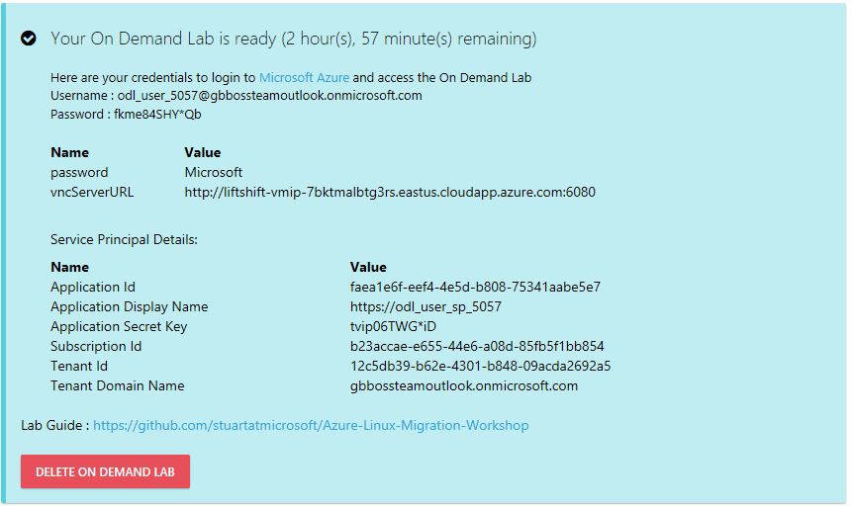
Let’s Get Started!
SAVE THE INFO PROVIDED WHEN YOU REACH THIS SCREEN!

Slide 15

Microsoft & Open Source

Slide 16
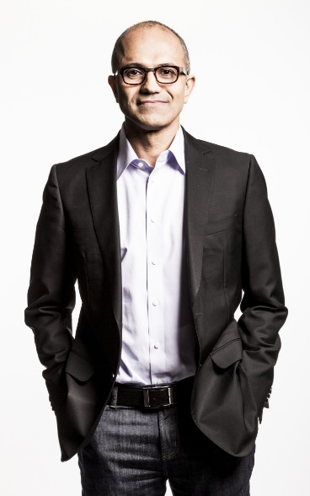
Inner Sourcing
In 2014, Microsoft CEO Satya Nadella directed all Microsoft engineers to "open source internally" - anyone at the company can see anyone else's code and use it as needed.
This vision is now a day-to-day reality for Microsoft engineers.
Notes:
Azure and Open Source – feedback from various UMICH departments is view that Azure is for “MSFT stack” and AWS is best for Open Source so need to emphasize our position on Open Source

Slide 17
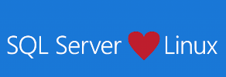

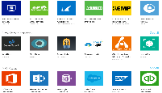






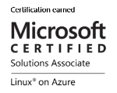
Microsoft + Open Source: Empowering Customers
Our Products
Our Offerings
Azure Marketplace
60% of all images in Azure Marketplace are based on Linux/OSS
SQL Server on Linux
Acquisition
Windows Subsystem for Linux
44% of VMs on Azure overall run Linux, and more than half of all new VMs run Linux
C:\Users\markhill> bash
44% / 1 in 3
HD Insight managed service on Linux
root@localhost: #
Run Linux on Windows natively
Our Partnerships
Our Employees
Ross Gardler President Apache SW Foundation
Brendan Burns
Co-Founder of Kubernetes
Partnership
Microsoft joins Eclipse Foundation
Partnership with the Linux Foundation for Linux on Azure certification
600 Million+
Lines of open source code
Partnership
Microsoft Open Source Hub
Jenkins project on Azure
Notes:
Notes coming soon – please check back on http://aka.ms/opensource for latest version

Slide 18

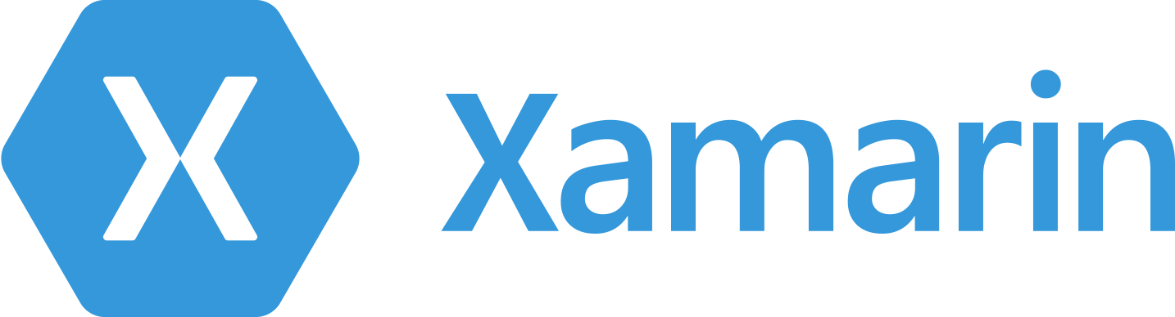





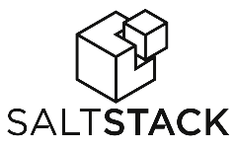
















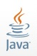

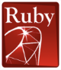








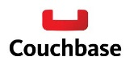







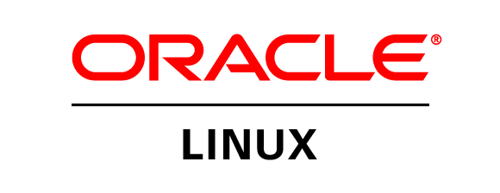
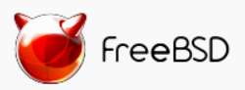

Azure is an open cloud
DevOps
Clients
Management
Applications
PaaS &
DevOps
App Frameworks
& Tools
Databases &
Middleware
Infrastructure
Notes:
P2

Slide 19
Why Linux on Azure
Our customers want it!
Roughly 1 out of 3 VMs run Linux & OSS
Enterprise grade cloud leadership
Only true hybrid cloud
Our goal is to be the most complete and open cloud

Slide 20







Linux images in the Azure Marketplace
Public Cloud
Azure Endorsed Linux Distributions
Published, maintained and supported by partners, curated & tested by Microsoft
Most endorsed distros maintain repos in each Azure region for fast updating
Standard Images
Customers can contact Linux vendor/partner for Linux support
Azure-related platform issues supported by Microsoft
Limited support for Linux issues -- from Microsoft
Premium Images
Microsoft engages the Linux vendor/partner on behalf of the customer for support
Includes updates, patches, and support through 24x7 web, email, chat and phone
Available for Red Hat Enterprise Linux and SUSE Linux Enterprise Server
Red Hat
Enterprise Linux
CoreOS
Ubuntu
OpenLogic
CentOS-based
SUSE Linux
Enterprise
Server
openSUSE
Oracle
Linux

Slide 21
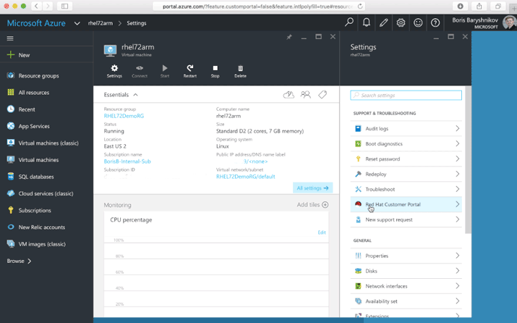
Accessing the Red Hat Customer Portal from Azure
With Azure “Pay As You Go” licensing, you can connect your subscription to Red Hat to access all Red Hat premium content and support.
Customers with existing Red Hat subscriptions may also seamlessly extend those to Azure using Red Hat Cloud Access
https://azure.microsoft.com/en-us/blog/red-hat-customer-portal-from-azure/
https://www.redhat.com/en/technologies/cloud-computing/cloud-access

Slide 22
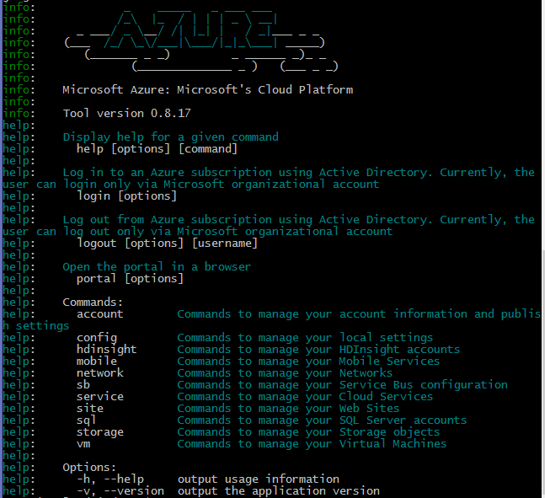
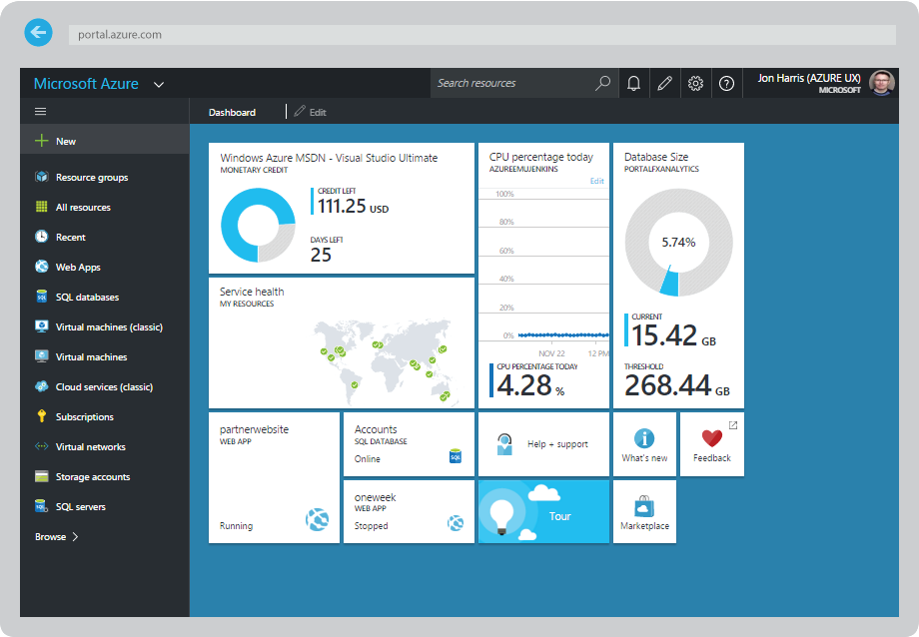
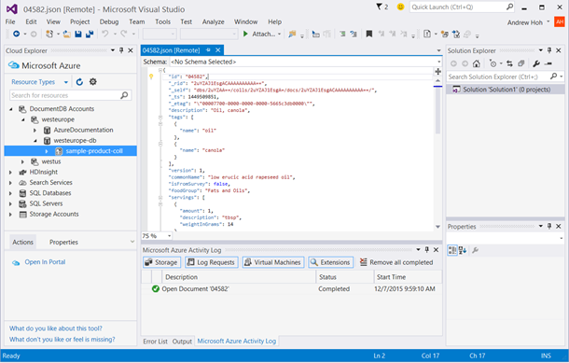
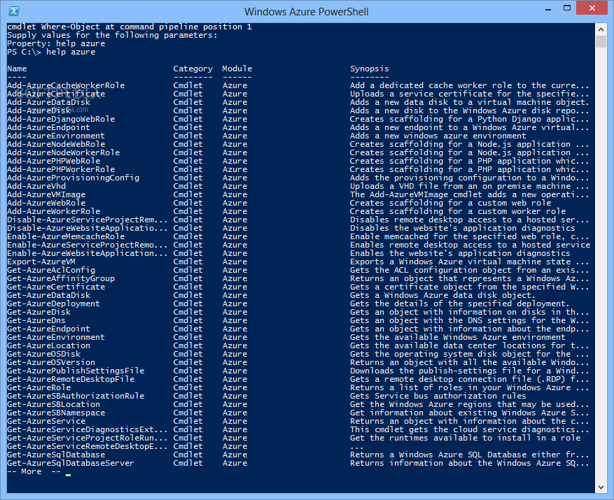
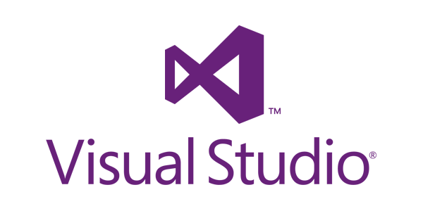
CLI, Portal, PowerShell, Visual Studio
Multiple ways to interact with Azure for any enterprise!
http://portal.azure.com
Linux Azure CLI Interface
http://aka.ms/azure-cli-2

Slide 23
Challenges 1 & 2 Introduction to & Provisioning in the Azure Linux CLI

Slide 24
Getting Started with the Azure Linux CLI
Available on Mac, Linux and Windows
Cloud Shell also available at http://portal.azure.com
Installation instructions http://aka.ms/azure-cli-2
If you are new to the Azure Linux CLI, a guide is provided:
https://docs.microsoft.com/en-us/cli/azure/get-started-with-azure-cli?view=azure-cli-latest
Once installed, you may use the Azure Linux CLI to log in to your subscription. All commands are entered via the “az” command:

Slide 25
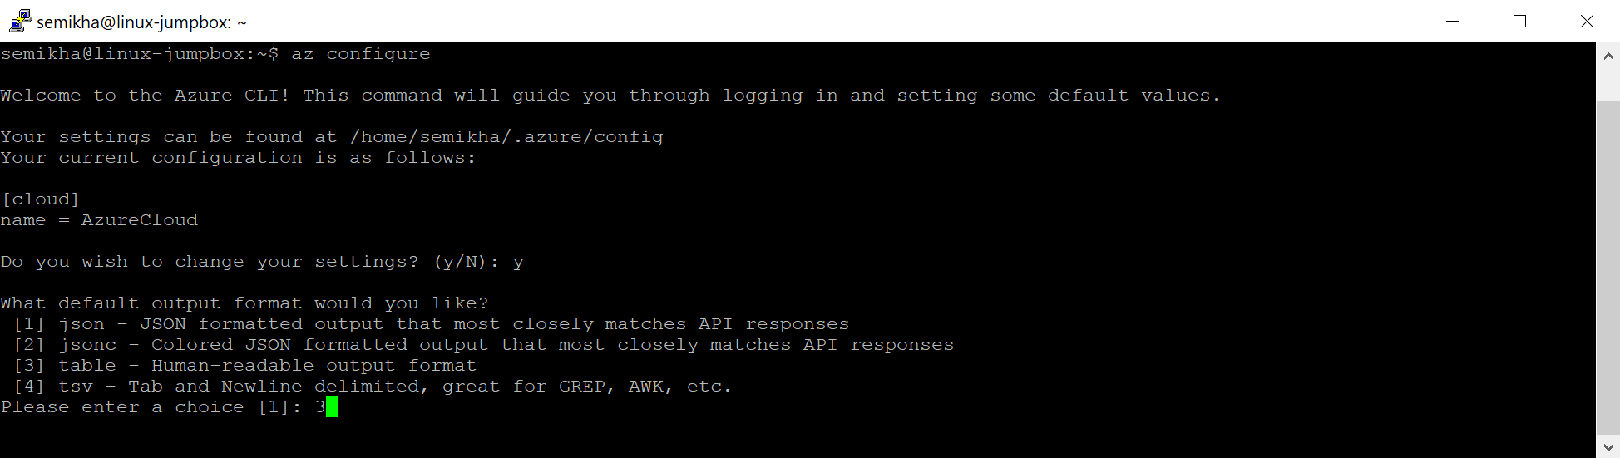

Getting Started with the Azure Linux CLI
To change the output format of the Azure Linux CLI, run the command “az configure”
The default output format is JSON
Pro Tip: You can modify the output results to any command with the --output or --out operator added to any common Azure CLI command (e.g. > az vm list --output json )

Slide 26
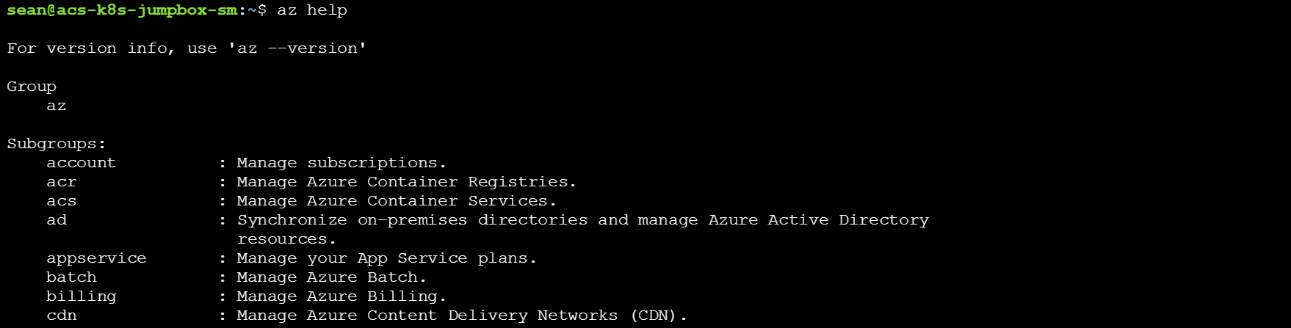
Getting Started with the Azure Linux CLI
To find a list of available options, use the command: “az help”
The default output format is JSON
Pro Tip: You can see syntax for a popular command with > az [command] … (the ellipses will force an error which results in syntax being returned)

Slide 27
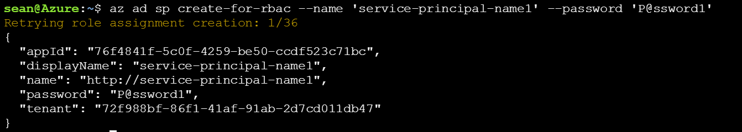
Getting Started with the Azure Linux CLI
A service principal is a service account that is created and attached to a specific subscription and is intended for integration purposes
Designed to allow control to extend to the resource-group level
To create a service principal: “az ad sp create-for-rbac --name=“my-service-principal" --role="Contributor" --scopes="/subscriptions/<INSERT SUBSCRIPTION ID HERE>"”

Slide 28
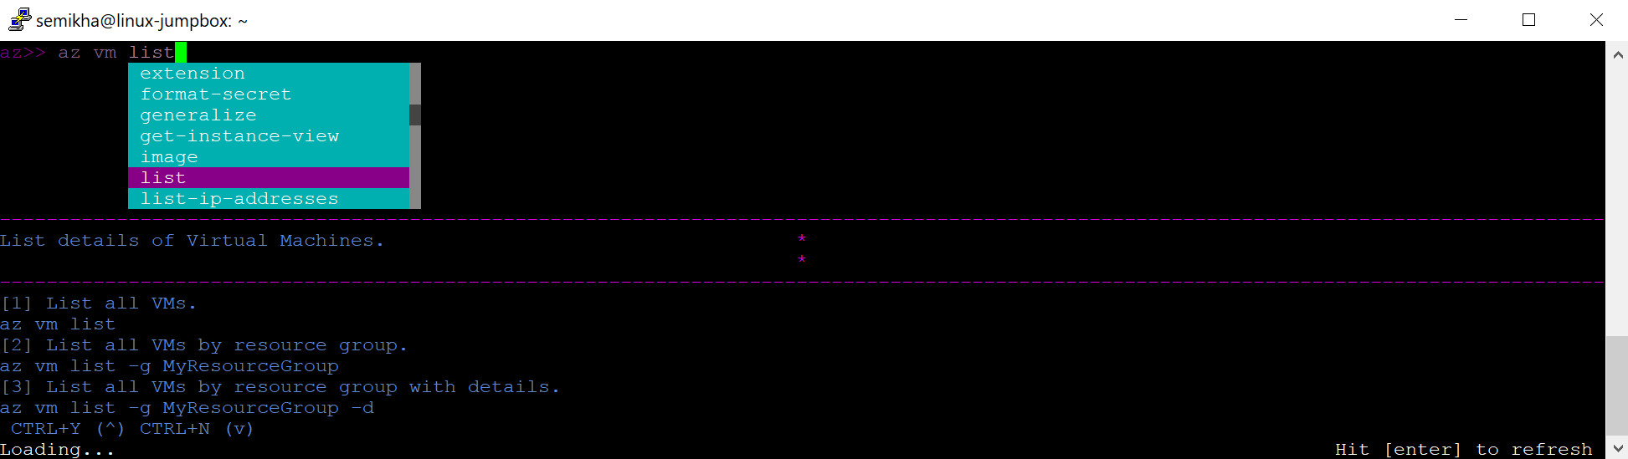
Getting Started with the Azure Linux CLI
The CLI can help you build the commands you need to run against your azure subscription
Interactive mode provides a TUI to assist in building commands
To create a service principal: “az interactive”

Slide 29
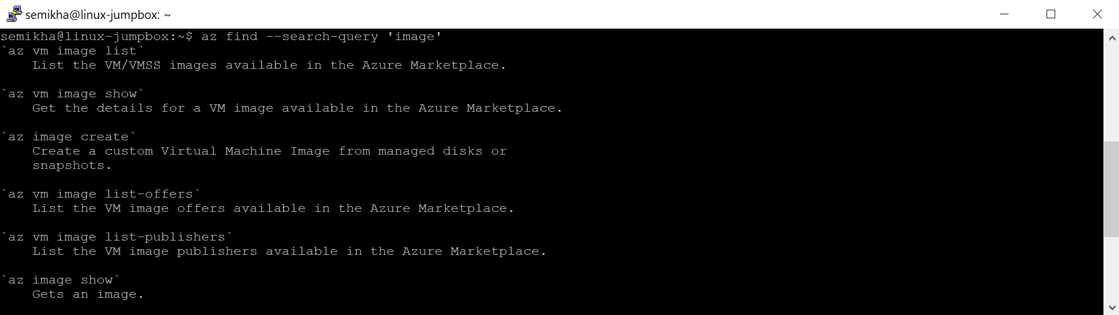
Getting Started with the Azure Linux CLI
You may query the CLI for the command you require, similar to a “man –k” / “apropos”
Query the CLI as follows: “az find --search-query ‘image’”

Slide 30
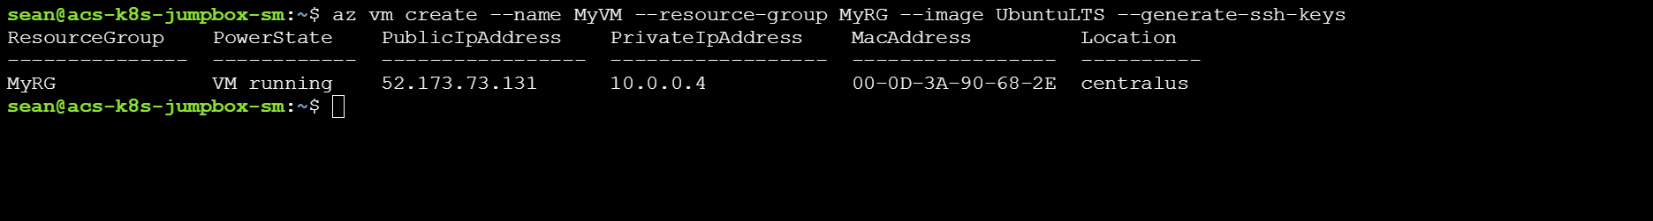
Getting Started with the Azure Linux CLI
The Azure CLI can also be used to create/destroy virtual machines
To create a VM: “az vm create --name myVM --resource-group MyRG --image UbuntuLTS”
At least these three parameters are required to create a virtual machine, however many more are often used

Slide 31
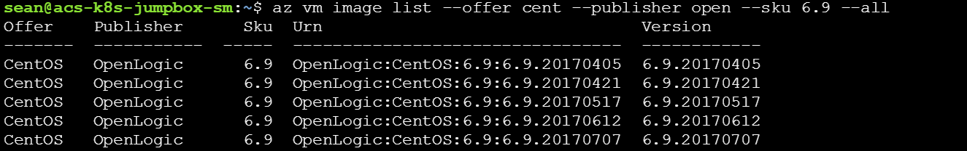
Getting Started with the Azure Linux CLI
Azure has a massive number of options for Linux virtual machines
To query the available options use: “az vm image list --offer CentOS --publisher OpenLogic --all”
Do not forget to use the “--all” command or the output may be incomplete

Slide 32
Challenge 3 Live Migrate your Linux Workloads to Microsoft Azure

Slide 33










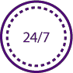


CloudEndure Live Migration
CloudEndure Key Technology Pillars
OS-based continuous | Replicate any applications
block-level replication | from physical / virtual /
 | cloud-based machines
Minimal footprint | 1-minute Any-to-Cloud
replication staging area | Image Conversion
Designed for busy | No disruption or reboot
databases without | of source machine(s)
impacting performance
CloudEndure Live Migration benefits
No need for special skills around OS/Apps/DBs
Cut project timelines
No DB-level tools required
Track progress
Identify project risks
Integration with Migration Hub
Reduce
Project management dashboard
_{human labor} ✓ Wide variety of supported OS’s
and complexity
Data is always in real-time sync
Cutover windows of minutes
Run migration & cutover jobs in parallel
Leverage Documented APIs
Integrated Post-Script support
Shorten cutover window /
downtime
Migration automation and optimization
No impact on source application
No impact on replication
Easily test in network isolation
Test for 100% confidence
No surprises during cutover
Non-disruptive easy testability
Predictable and no-risk cutover

Slide 34
CloudEndure benefits - summary
Replicate from physical or virtual machines (any hypervisor)
Replicate from other clouds (such as AWS, Google, Rackspace etc.)
Support for wide variety of OS types and flavors, both Windows and Linux
Supports any application and DB (such as Oracle, SQL servers, SAP, SharePoint etc.)
Simple to deploy (agent only, no appliances or storage required in source location)
Continuous block-level replication
Simple orchestration (launch target machines at scale via API and post-script automation)
Lightweight and non-disruptive agent (no reboot or performance impact)
Supports simple fail-back

Slide 35


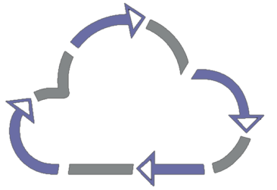








Replication workflow with CloudEndure
Blueprint corrections needed?
Ready?
Assessment
Identify machines, networking, instance rightsizing
Install Agents *
Replication begins into lightweight staging area
Configure Blueprint
Can be updated at any time without disrupting replication
Test target servers
Launches and converts machine(s)
* No reboot, No performance impact, No OS / App / DB configuration
Cutover/Failover

Slide 36











CloudEndure Architecture Azure
Configure Target Blueprint
Console
Launch Target
Instance(s)
API (Staging)
API (Launch Target)
Source
Target
Replication Servers Subnet (staging area)
Replica Subnet(s)
Boot
Boot
Continuous
Replication
Traffic
Replica instance
Agent
CloudEndure Replication Server(s)
Cluster
CloudEndure
Machine
Converter
Boot
Boot
Replica instance
Agent
Replication Volumes
Replica Volumes

Slide 37
Challenge 4 Analyze, size, and estimate the cost of your enterprise in Microsoft Azure

Slide 38


Technical Deliverables….
Inventory Analysis
Requirements Definition
Cloud-fit Analysis
Dependency Mapping
Application Mapping
Financial Modeling
Migration Automation
Enterprise IT

Slide 39
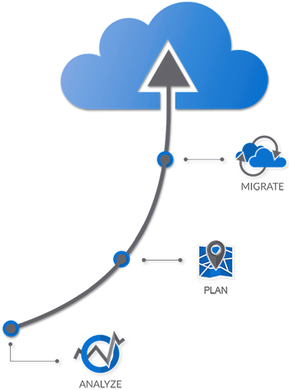
The StratoZone Solution
The most powerful end-to-end cloud-enablement platform for accelerating cloud consumption.
StratoBeam®
StratoSlate®
StratoProbe®

Slide 40




Our Cloud Planning Approach
Understand
Your
Environment and Needs
Plan Your Requirements and Create Your Roadmap
Identify Cost Savings and Best-Fit Products
Create Your Migration Plan and Migrate Assets
Fast and actionable results through automation!

Slide 41
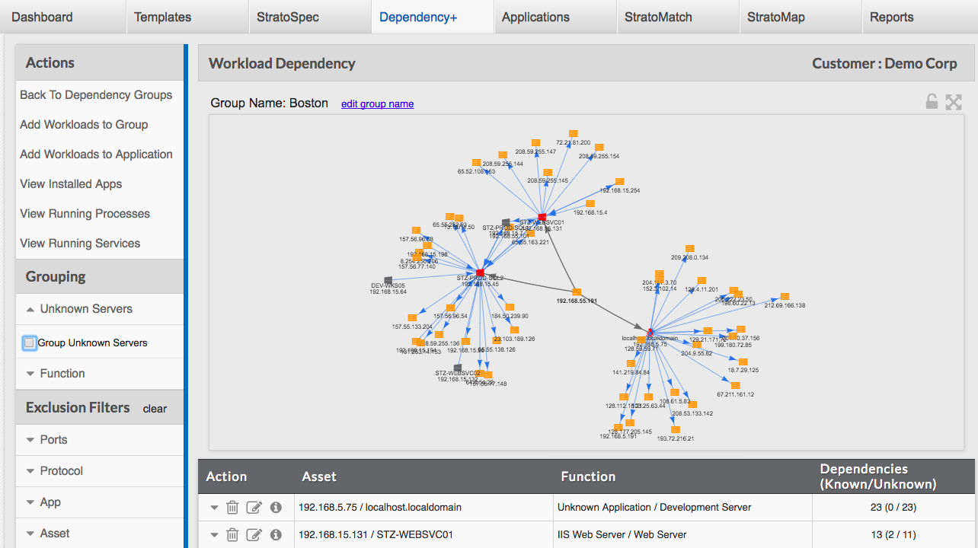
Industry-leading, cognitive dependency & app mapping

Slide 42
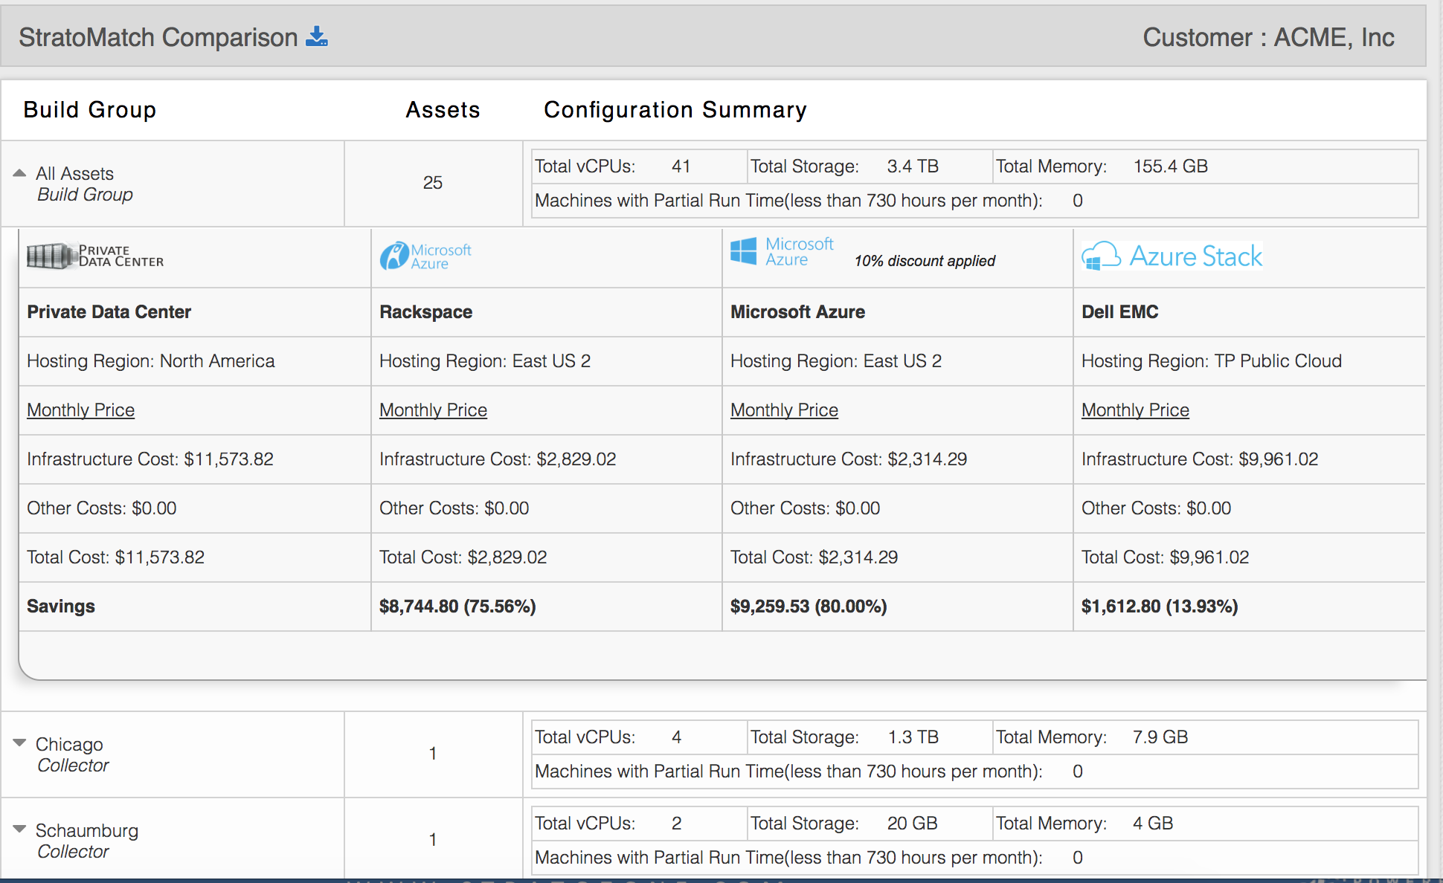
Multi-scenario savings and ROI comparisons

Slide 43
Challenge 5 Overview of Optional Challenges

Slide 44
Challenge 5a
Introduction to Azure Container Service (AKS)

Slide 45
Introduction to AKS
Container hosting solution optimized for Azure
Azure-hosted control plane
Only pay for resource consumption
Automated upgrades, self-healing, easy scaling
Ease Kubernetes management with open source upstream portability

Slide 46
Introduction to AKS
Fully managed Kubernetes control plane:
No VMs to operate; No patching required
Provisioned in under 2 minutes
SLA-available service (99.95%)
Transparently scales with cluster size:
1, 50, 100, 250, 500, etc.
Upstream Kubernetes
Free (no charge for control plane)

Slide 47
Introduction to AKS
Automated Kubernetes upgrades
Self-healing Control Plane
etcd SSD backed, automated, H/A, backup/restore
Customized networking (Azure VNETs, CNI)
Cluster scaling
TLS everywhere. Backed by Azure KeyVault
RBAC and Azure AD integrated
Hybrid Clusters (future)

Slide 48
Challenge 5b
Integrating Ansible CLI to Microsoft Azure

Slide 49
Integrate Ansible to Azure
Examining an Ansible Playbook utilizing an Azure Module
- hosts: localhost
connection: local
gather_facts: no
tasks:
- name: Create Azure Deploy
azure_rm_deployment:
state: present (Set to absent if you want to remove)
location: eastus2 (Specify your Azure Data Center)

Slide 50
Integrate Ansible to Azure
resource_group_name: AnsibleTestCentOSRG (Specify RG)
parameters:
adminUsername:
value: ansibleadmin
sshKeyData:
value: “<Your SSH Public Key>"
template_link: 'https://raw.githubusercontent.com/stuartatmicrosoft/ansible-playbook-repo/master/centos7-prem.json'
register: azure

Slide 51


Integrate Ansible to Azure
Installing Required Python Modules & Azure SDK
yum -y install ansible
useradd ansible
pip install --upgrade pip
pip install ansible[azure]
su - ansible
mkdir $HOME/.azure

Slide 52
Integrate Ansible to Azure
Configuration File Overview:
tee $HOME/.azure/credentials <<EOF
[default]
subscription_id=
tenant=
client_id=
secret=
EOF

Slide 53
Integrate Ansible to Azure
Create Service Principal for Anisble to connect to Microsoft Azure:
az account show --expanded-view
Obtain value for “SubscriptionId” and “TenantId”
az ad sp create-for-rbac --name=“<name-of-sp>” --role=“Contributor”--scopes=“/subscriptions/<SubscriptionId>”
Make note of both “AppId” and “Password”

Slide 54

Integrate Ansible to Azure
Step by Step Overview:
ansible-playbook centos-azure-create.yml

Slide 55
Integrate Ansible to Azure
Deploy and Test an IaaS Virtual Machine:
vi /etc/ansible/hosts
ansible -m ping all
ansible-playbook helloworld.yml
az account list --output table
az group list
az vm list -g AnsibleTestCentOSRG -d

Slide 56
Integrate Ansible to Azure
Population of ~ansible/.azure/credentials file:
"subscription_id“ | az account list --output table
"tenant“ | az account show -s <subscription>
"client_id“ | az ad sp create-for-rbac (AppId)
"secret“ | az ad sp create-for-rbac (Password)

Slide 57
Challenge 5c
Containerize an application with Docker

Slide 58











About Docker, Inc. Docker is the company driving the container movement
Company driving the container movement and industry standards
Container platform for both developers and IT pros
Customers Include:
21.0M
24B
77K%
Docker Hosts
Container downloads
Growth in Docker
job listings

Slide 59
What is a Docker container?
Containers are application level tools
Package software and dependencies into an isolated process
Share the underlying OS kernel
Available for Linux and Windows

Slide 60
Comparing Containers and VMs
Containers are an app level construct
VMs are an infrastructure level construct to turn one machine into many servers

Slide 61
Containers and VMs together
Containers and VMs together provide a tremendous amount of flexibility for IT to optimally deploy and manage apps.

Slide 62
Docker Enterprise Edition: Container management and security platform
CERTIFIED PLUGINS FOR NETWORKING AND STORAGE
CERTIFIED CONTAINERS FOR ISV APPS
SECURE SOFTWARE SUPPLY CHAIN
INTEGRATED CONTAINER LIFECYCLE MANAGEMENT
MULTI-ARCHITECTURE OPERATIONS: WINDOWS, LINUX, MAINFRAME
CONTAINER RUNTIME
CERTIFIED INFRASTRUCTURE – OS AND CLOUD

Slide 63
Modernize Traditional Apps [MTA] with Docker Enterprise Edition to simplify and accelerate cloud migration
Get immediate savings without disruption
Portability
Agility
Security
Hybrid
Cloud-Ready
Isolation
& Integrity
2x Faster
Reducing total costs by 50%
Notes:
Docker MTA delivers the following benefits

Slide 64
Modernization Traditional Apps [MTA] with Docker Enterprise Edition
Repackage apps and migrate to Azure in less than 5 days without recoding
App
Existing
Application
Convert to a
Docker EE Container
Modern
Infrastructure
Modern Methodologies
Ongoing Innovation
We are here to help! Learn more about our program
www.docker.com/MTA

Slide 65
Challenge 5d
Introduction to Azure Container Service (ACS)

Slide 66

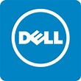
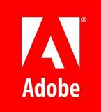


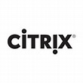




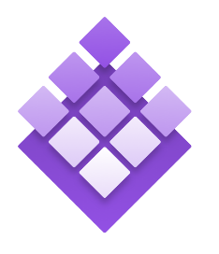
Introduction to ACS
“Deploy and manage containers using the tools you choose”
Standard Tooling and API support
Streamlined provisioning of Mesosphere DC/OS, Docker Swarm and Kubernetes
Azure Container Service
Kubernetes
DC/OS
Swarm

Slide 67
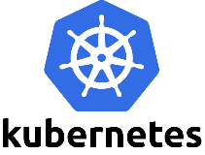
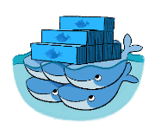

Introduction to ACS
Managed delivery of optimized container hosting solution
Manage container applications using popular open source tooling
Scale & orchestrate using Mesosphere DC/OS, Swarm, or Kubernetes
Migrate container workloads to and from Azure
Full support from Microsoft / Docker / Mesosphere
Leverage Azure Platform capabilities
Azure Resource Manager
VM Scale Sets
Networking
Security

Slide 68
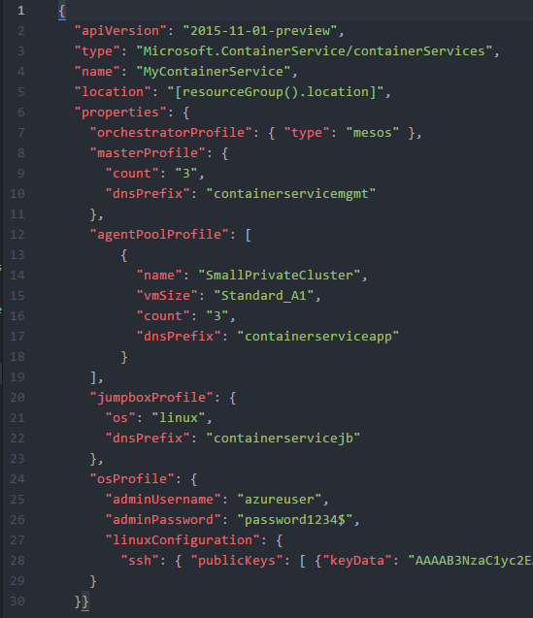
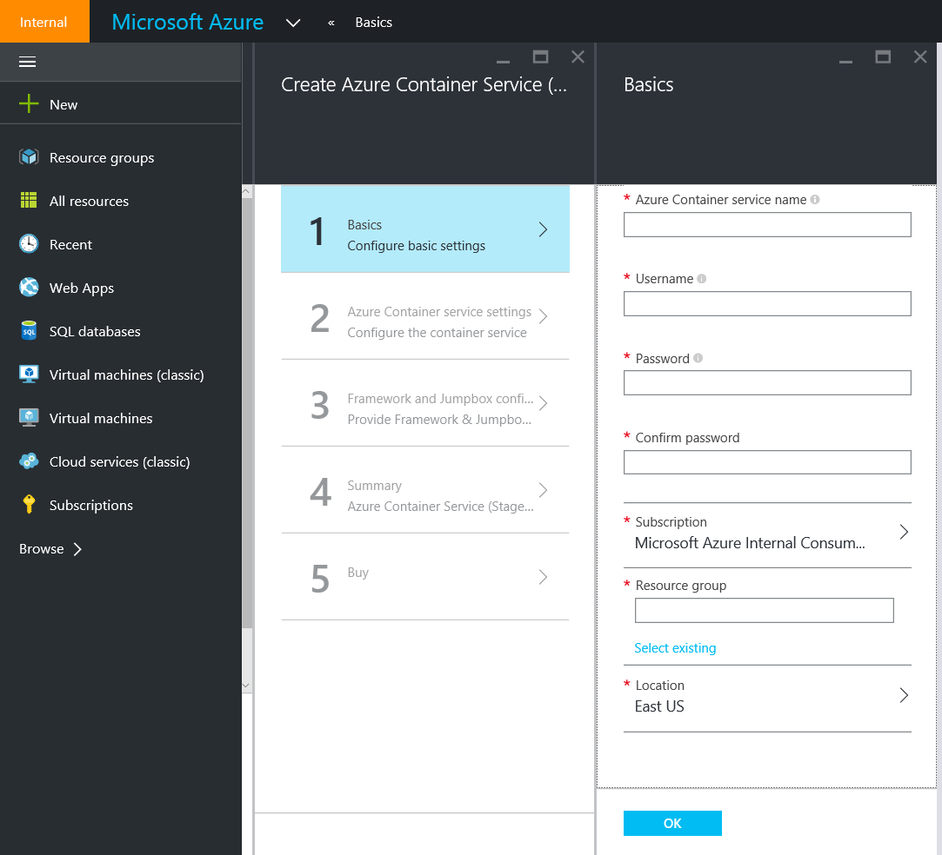
Introduction to ACS
Deploy using the Portal, CLI, or ARM

Slide 69
ACS-Engine Overview
Generates ARM templates for Azure Container Service clusters
Go based tool can be run in Docker or natively on Windows, OS X, Linux
Cluster defined by a JSON cluster definition file
Output is an ARM template for deploying ACS into Azure
Deploy via Azure CLI or PowerShell
Some of the customization options:
Choice of DC/OS, Kubernetes, or Swarm orchestrators
Docker cluster sizes of 1200
Custom VNET
Multiple agent pools where each agent pool can specify:
standard or premium VM Sizes
node count
Virtual Machine Scale Sets or Availability Sets
Storage Account Disks or Managed Disks (under private preview)

Slide 70
SURVEY
Please complete our 10-question survey:
https://aka.ms/linuxsurvey

Slide 71

© 2017 Microsoft Corporation. All rights reserved.

